Slide 1
Virtual Mouse
By: Kyle Moorhead

Slide 2
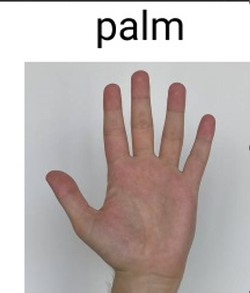
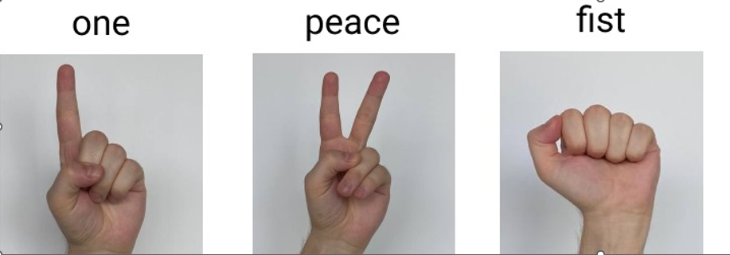
Gestures Trained
Gesture
One
Peace
Palm
Notes:
Over ½ Million images
Over 30 thousand different people in different conditions

Slide 3
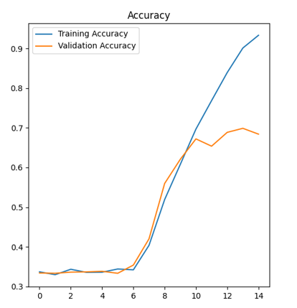
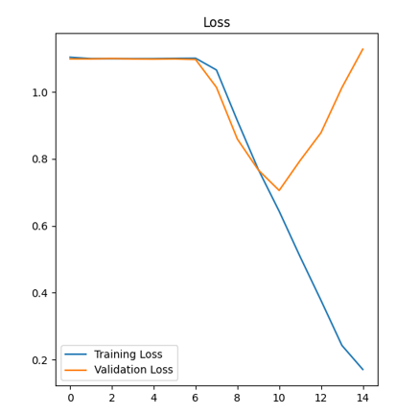
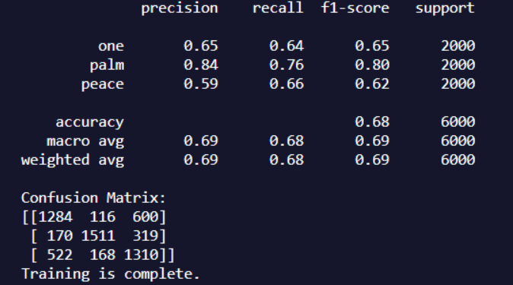
Results
Hyperparameters:
Epochs: 15
Conv2d Layers: 6
Optimizer: Adam
Images: 5000 per gesture
Batch Size: 32
Loss: Categorical Crossentropy
Train/Test Split: 60/40

Slide 4
Challenges
Pre-processing Images
Dataset claimed all images were 1920x1080. Reality: Most images 1440x1920. The variation in size and shape of images was distorting training data so the model failed to train.
Multi-Labeled images
Some Images had multiple hands in frame confusing the training.
Network Structure
I had been using too simple of a structure for the complexity of my problem. Not enough Conv2D layers to allow for the image to be processed properly.

Slide 5
Lessons Learned
L2 normalize
Attempted to L2 normalize trying to understand why my model was not training. (This was before determining the image size/shape problem.
Dropout Layers
Attempted multiple dropout layers in different places in the model structure trying to get the model to train. (Again before image size/shape problem was solved).
Batch Normalization
Attempted batch normalization after first dense layer, before categorizing layer. (Again before image size/shape problem)

Slide 6
Lessons Learned
Data Augmentation
Briefly attempted data augmentation. Takes existing dataset and shuffles it around. Rotates, flips, zooms – in an attempt to create a more diverse dataset if original is lacking.
Gave up on this and instead increased number of training images. 5000 was about the most I could process in a “reasonable” amount of time.
Every little thing matters
After I solved the image shape/size problem training still didn’t seem to work. So, I grabbed a different dataset and tried to train my on my architecture. It worked great – but the dataset was much simpler than mine. I realized my architecture would need to be more complex to handle the task at hand. When I increased the number of layers to 6 the model trained for the first time ever!

Slide 7
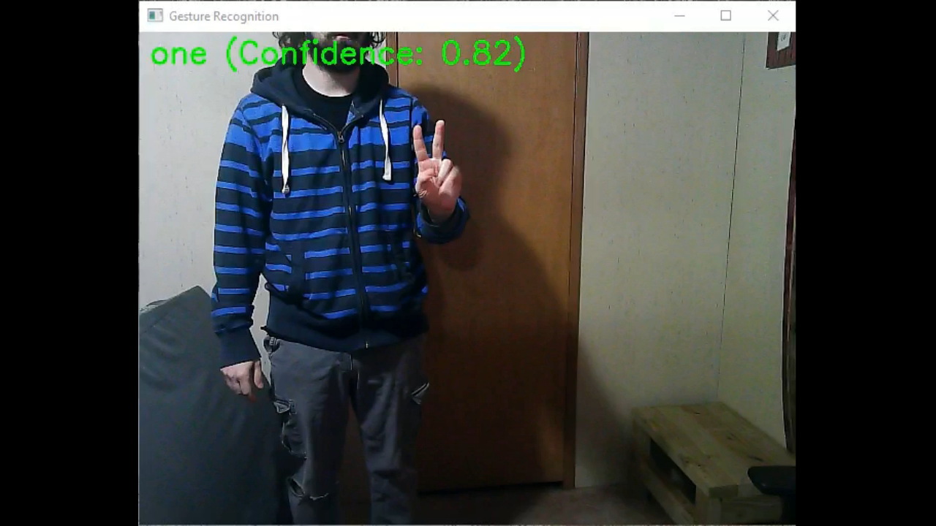
Questions?

Slide 8
Questions?

